Slide 1
LAB LECTURE 3
LC: Ms. Shiza Riaz Memon

Slide 2
Mutual Exclusion
Critical Section: Area where all shared resources are present.
It is only accessible to one process at a time.
MUTUAL EXCLUSION: Makes sure that processes access the shared resources or data in a serialized way.
There are many ways to achieve Mutual Exclusion. One way is through Lamport’s Algorithm of Mutual Exclusion.

Slide 3
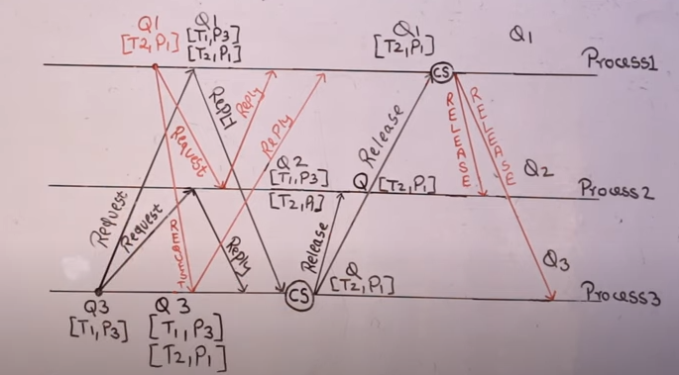

Slide 4
Lamport’s Algorithm
Pi sends request to all Pjs.
Pi makes entry in its own queue
Pj receives request messages
Pj makes entry in its own device and send reply to pi
Conditions for critical section
Pi has received reply from all those pjs whom it has sent request
In queue his own request is at the top
Pi exits the critical section and removes itself from the queue
Pi broadcasts release messages
On receiving messages, Pjs remove Pi’s entry.

Slide 5
Message Complexity
Lamport’s Algorithm requires invocation of 3(N – 1) messages per critical section execution. These 3(N – 1) messages involves
(N – 1) request messages
(N – 1) reply messages
(N – 1) release messages

Slide 6
Drawbacks of Lamport’s Algorithm
Unreliable approach: failure of any one of the processes will halt the progress of entire system.
High message complexity: Algorithm requires 3(N-1) messages per critical section invocation.

